Slide 1
1
DPNLP : distance based peripheral nodes label propagation algorithm for community detection in social networks
THESIS :
Zarezadeh, M., Nourani, E. & Bouyer, A. DPNLP: distance based peripheral nodes label propagation algorithm for community detection in social networks. World Wide Web 25, 73–98 (2022). https://doi.org/10.1007/s11280-021-00966-4.
Student ： JING-YE YANG
Student ID : M11102155
2023/05/17

Slide 2
Outline
Introduction
Definition
Algorithm
Experiment & Simulation
Conclusion
2023/05/17

Slide 3
Introduction
2023/05/17

Slide 4
Introduction
Community Detection Algorithm (CDA)
- An algorithm for detecting connected group in complex network.
Protein-Protein interaction network
H. Qureshi, Amir; Chaoji, Vineet; Maiguel, Dony; Hafeez Faridi, Mohd; J. Barth, Constantinos; M. Salem, Saeed; et al. (2015): Platelet Protein-Protein Interaction (PPI) network.. PLOS ONE. Figure. https://doi.org/10.1371/journal.pone.0007627.g010
2023/05/17

Slide 5


Introduction
Label Propagation Algorithm (2007)
- A linear time complexity community detection algorithm.
We assume then consider node 1
We assume start from node 5
2
6
2
6
2
6
2
6
2
6
1
1
1
2
9
9
9
2
9
5
5
2
3
3
5
1
9
7
7
3
7
3
7
3
7
4
8
8
8
8
4
8
4
4
4
Node 1 gets label $\{2,2,4,6,8,9\}$
Node 5 gets label $\{1,2,3,4\}$
First initial unique label to each node
Then start to get labels from your neighbors
Assume we randomly choose 2 as node 5’s dominate label.
Choose the label random if the maximum number of label are equal.
We choose 2 as node 1’s dominate label.
Random select $⇒$ Results not really the same !!!
PhysRevE.76.036106,Near linear time algorithm to detect community structures in large-scale networks Raghavan, Usha Nandini and Albert, R\'eka and Kumara, Soundar Phys. Rev. E, 2007, Sep,American Physical Society,10.1103/PhysRevE.76.036106,https://link.aps.org/doi/10.1103/PhysRevE.76.036106\
2023/05/17

Slide 6
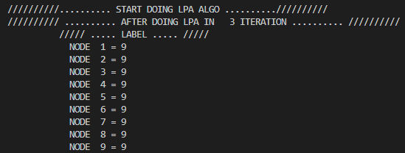
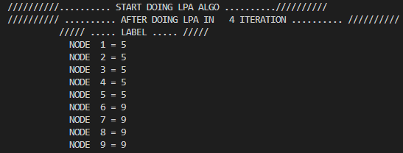
Introduction
Label Propagation (2007)
After times iterations could get some bad cases
$$∵randomly choose dominate label$$
$$∴different results$$
9
9
5
9
2
6
2
6
9
9
9
5
5
9
9
3
5
1
9
7
9
5
3
5
1
9
7
9
4
8
4
8
9
9
5
9
2023/05/17

Slide 7
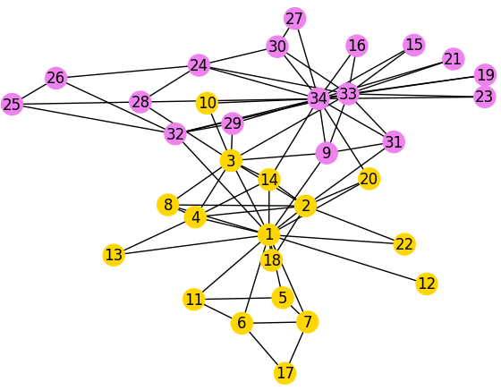
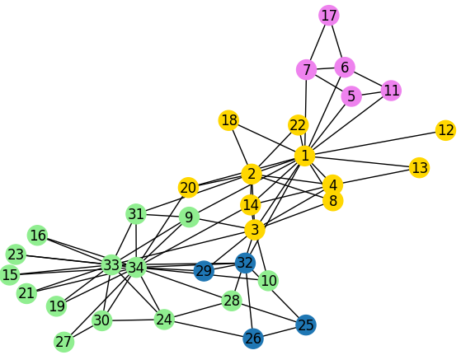
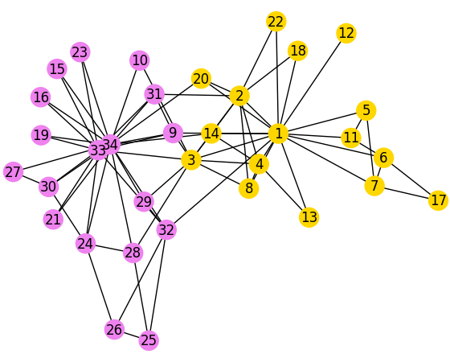
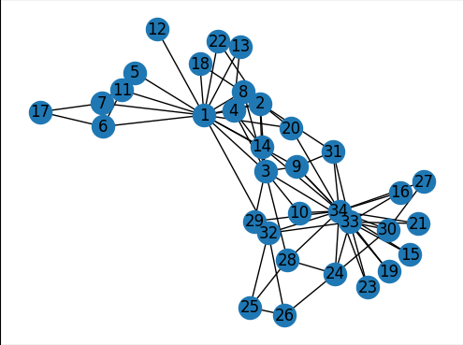
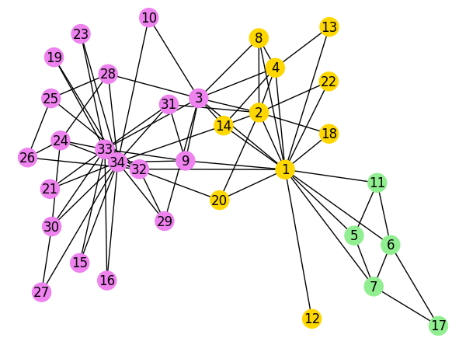
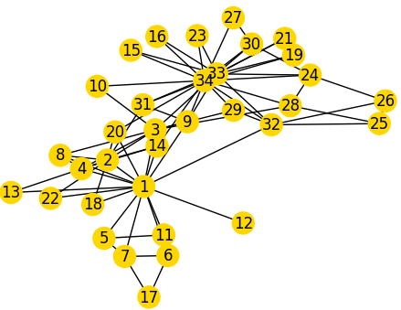
Introduction
Zachary’s Karate Dataset :
( Using LPA )
( Using DPNLP )
Only 1 result
4 different results
$$39\%$$
$$3\%$$
$$52\%$$
$6\%$
$$100\%$$
W. W. Zachary, Aninformation flow model for conflict and fission in small groups, Journal ofAnthropological Research 33, 452-473 (1977).
2023/05/17

Slide 8
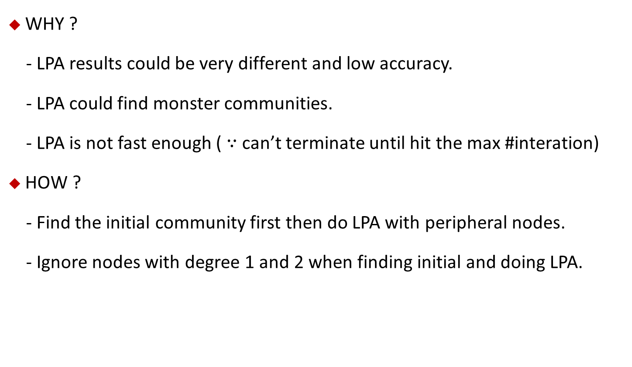
Introduction
WHY ?
- LPA results could be very different and low accuracy.
- LPA could find monster communities.
- LPA is not fast enough ( $∵$ can’t terminate until hit the max #interation)
HOW ?
- Find the initial community first then do LPA with peripheral nodes.
- Ignore nodes with degree 1 and 2 when finding initial and doing LPA.
2023/05/17

Slide 9
Introduction
Application ?
- Used in many network detection , for example :
- social network , finding the relationship between humanity.
- Biological network , finding the similar genome-wide.
Improvement ?
- The execution time.
- The accuracy.
- Results become as similar as possible.
2023/05/17

Slide 10
Definition
2023/05/17

Slide 11

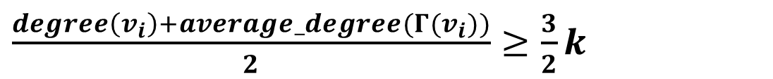
Definition
Core node :
- nodes are more density would become core node.
- three condition to recognize core nodes.
$$degree\left(v_{i}\right)≥ {(\frac{E}{N})}^{2}$$
$$degree\left(v_{i}\right)≥average_degree(Γ(v_{i}))$$
$\frac{degree\left(v_{i}\right)+average_degree(Γ(v_{i}))}{2}≥\frac{3}{2}k$
2023/05/17

Slide 12
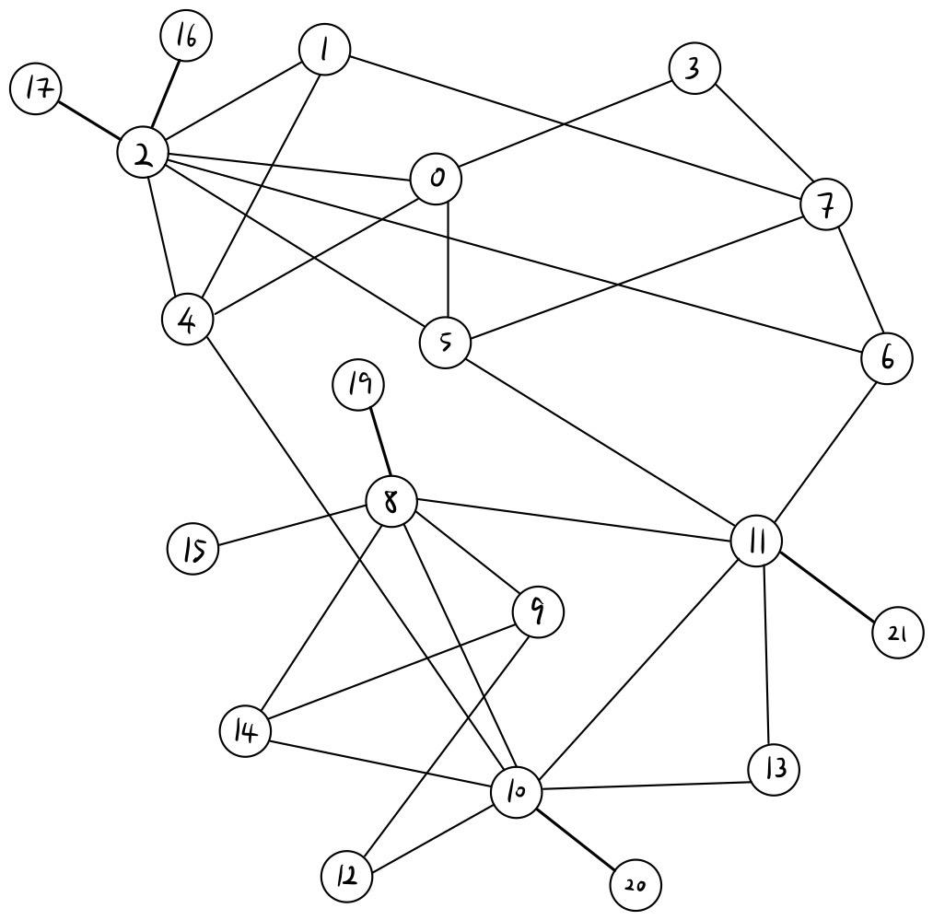
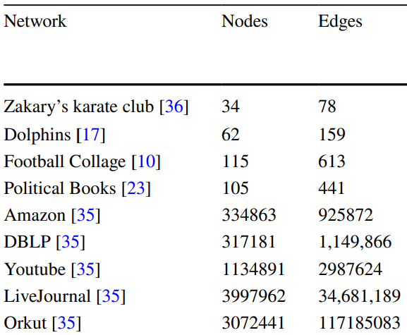



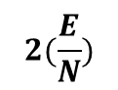
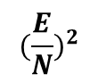
Definition
Core node :
- First condition
$$degree\left(v_{i}\right)≥ {(\frac{E}{N})}^{2}$$
$$N(\#node)=21$$
$${degree\left(2\right)=7 ≥(\frac{E}{N})}^{2} =2.4693$$
$$2(\frac{E}{N})$$
$${(\frac{E}{N})}^{2}$$
$$E(\#edge)=33$$
4.58 | 5.26
5.12 | 6.57
10.66 | 28.41
8.4 | 17.64
5.52 | 7.644
7.25 | 13.14
5.625 | 6.39
17.34 | 72.25
76.28 | 1454.71
$${(\frac{E}{N})}^{2} =2.4693$$
Cause big dataset
2023/05/17

Slide 13
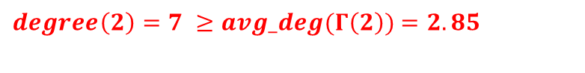

Definition
Core node :
- Second condition
$$degree\left(v_{i}\right)≥average_degree(Γ(v_{i}))$$
$degree\left(2\right)=7 ≥avg_deg(Γ\left(2\right))$ $=2.85$
$$Γ\left(2\right)=\{0,1,4,5,6,16,17\}$$
$$Γ\left(2\right)=\{0,1,4,5,6,16,17\}$$
$$Γ\left(2\right)=\{0,1,4,5,6,16,17\}$$
$$deg\left(0\right)=4$$
$$avg_deg(Γ\left(2\right))$$
$$deg\left(1\right)=3$$
$$=\frac{4+3+4+4+3+1+1}{7}$$
$$deg\left(4\right)=4$$
$$deg\left(5\right)=4$$
$$=2.8571$$
$$deg\left(6\right)=3$$
$$deg\left(16\right)=1$$
$$deg\left(17\right)=1$$
2023/05/17

Slide 14
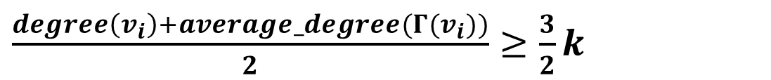



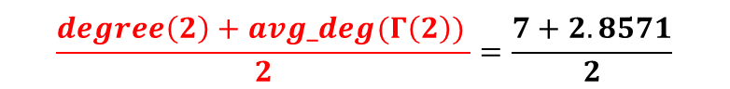
Definition
Core node :
- Third condition
$\frac{degree\left(v_{i}\right)+average_degree(Γ(v_{i}))}{2}≥\frac{3}{2}k$
$$k=network^{′}s avgrage degree$$
$$\frac{degree\left(2\right)+avg_deg(Γ\left(2\right)) }{2}=\frac{7+2.8571}{2}$$
$$=\frac{2E}{N}$$
$$=4.9285$$
$$=\frac{2(33)}{21}$$
$$\frac{3}{2}k=\frac{3}{2}∗3.1428=4.714$$
$$=3.1428$$
$$node 2 is a core node !$$
2023/05/17

Slide 15
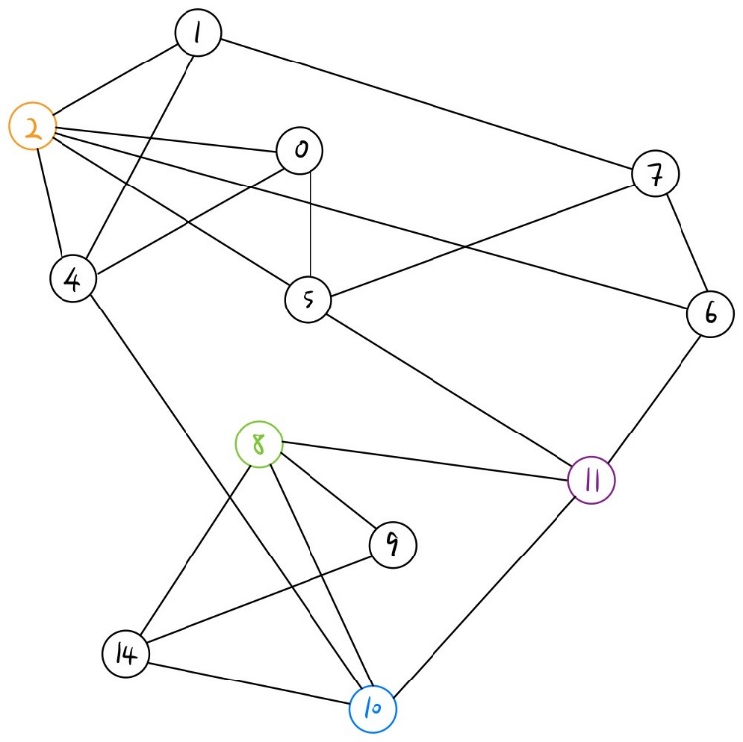
Definition
Peripheral node :
- node that it’s label is very different to it’s neighbors label.
- how different ?
- experiment told us less than 70%.
Assume after few steps in DPNLP
0
2
7
11
label
2 | 2 | 10 | 10
Label of node 5 is 10 is quite different to it’s neighbor label
Nodes will continue do LPA !!!
2023/05/17

Slide 16
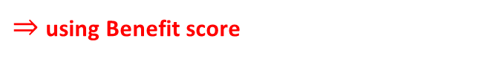
Definition
Benefit score :
How to decide node a ‘s dominate label ?
How to decide node a ‘s dominate label ?
$⇒$using Benefit score
x
$$label\left(x\right)=x$$
$$label\left(a\right)= ?$$
a
z
$$label\left(z\right)=k$$
y
$$label\left(y\right)=x$$
2023/05/17

Slide 17


Definition
Benefit score :
- sum of degree
- Distance between nodes and it’s core node
- #edge between target node and community
$$=\sum_{v∈N\left(u\right), v∈C_{k}}{deg⁡(v)}$$
$$sum_of_degree(u,C_{k})$$
$$d\left(u,C_{k}\right)=\min\left\{dis\left(v\right) , v∈N\left(u\right)∧v∈C_{k}\right\}+1$$
$$L\left(u,C_{k}\right)=\sum_{i∈N\left(u\right), i∈C_{k}}{e_{ui}}$$
2023/05/17

Slide 18
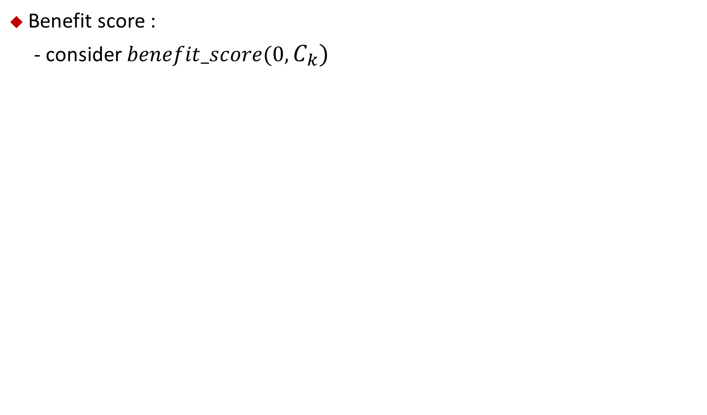


Definition
Benefit score :
- consider $benefit_score(0,C_{k})$
2
4
5
label
2 | 10 | 10
$benefit_score\left(0,C_{2}\right)$
d$\left(0,C_{2}\right)$
$sum_of_degree\left(0,C_{2}\right)$
$L\left(0,C_{2}\right)$
$$=min\left\{dis\left(v\right) , v∈N\left(2\right)∧v ∈C_{2}\right\}+1$$
$$=\sum_{v∈N\left(0\right) , v∈C_{2}}{deg\left(v\right)=deg\left(2\right)=7}$$
$$=\sum_{i∈N\left(2\right) , i∈C_{2}}{e_{0i}}$$
$$=\frac{t−\text{d}\left(0,C_{2}\right)}{t}∗\{\left(k∗L\left(0,C_{2}\right)\right)+sum_of_degree\left(0,C_{2}\right) \}$$
$$=min\left\{dis\left(2\right)\right\}+1$$
$$=e_{02}$$
$$=\frac{6−1}{6}∗\{\left(3.1428∗1\right)+7\}$$
$$=min\left\{0\right\}+1$$
$$=1$$
$$=1$$
$$=8.4523$$
2023/05/17

Slide 19
Algorithm
2023/05/17

Slide 20
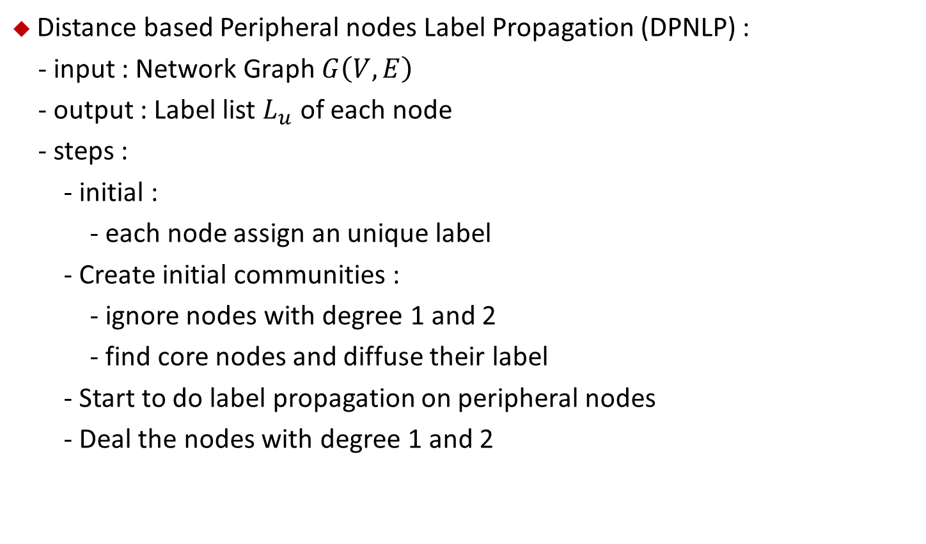
Algorithm
Distance based Peripheral nodes Label Propagation (DPNLP) :
- input : Network Graph $G\left(V,E\right)$
- output : Label list $L_{u}$ of each node
- steps :
- initial :
- each node assign an unique label
- Create initial communities :
- ignore nodes with degree 1 and 2
- find core nodes and diffuse their label
- Start to do label propagation on peripheral nodes
- Deal the nodes with degree 1 and 2
2023/05/17

Slide 21
Algorithm
DPNLP :
Initial
Create initial community
Label propagation
Finalizing community
2023/05/17

Slide 22
Algorithm
DPNLP :
Initial
Create initial community
Label propagation
Finalizing community
2023/05/17

Slide 23
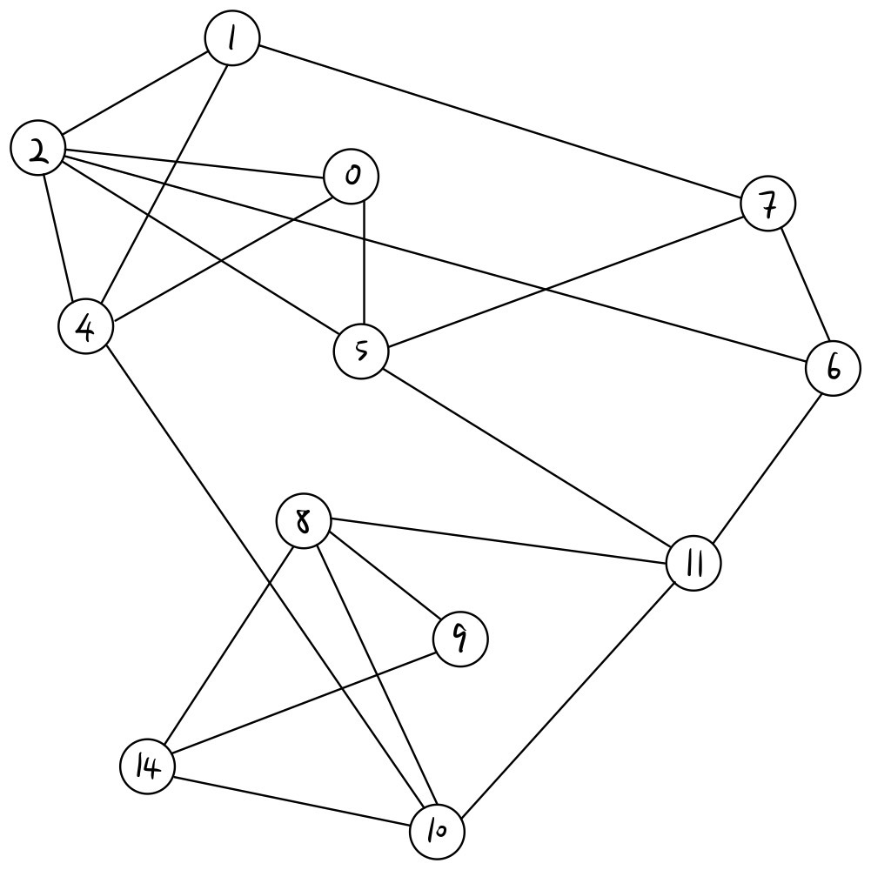
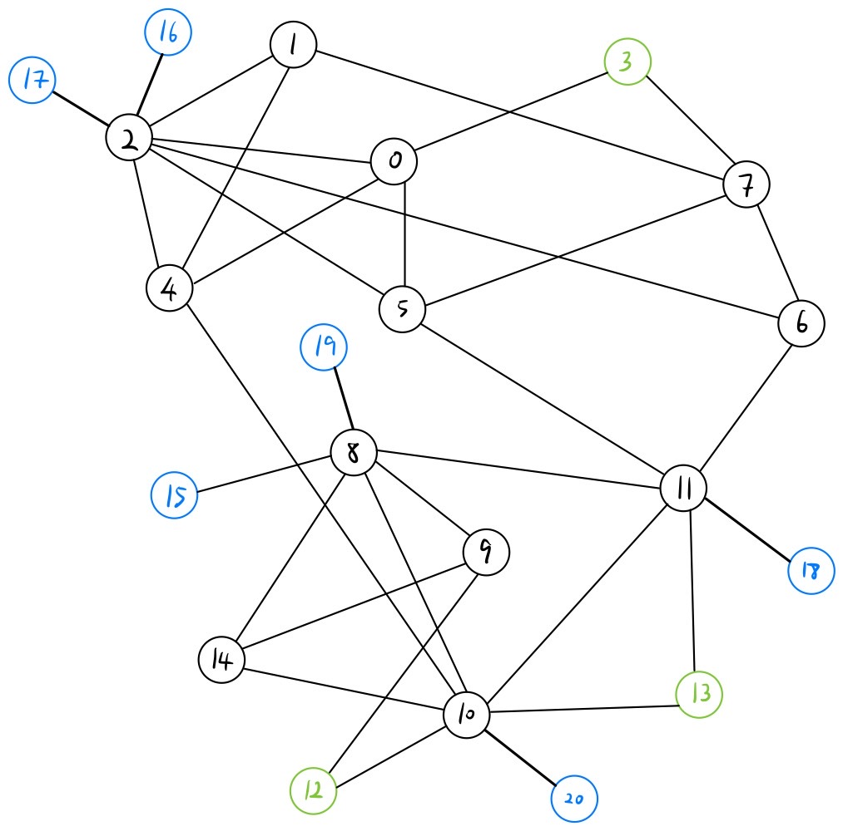
Algorithm
DPNLP :
- ignore degree 1 and 2
Degree 2
Degree 1
2023/05/17

Slide 24
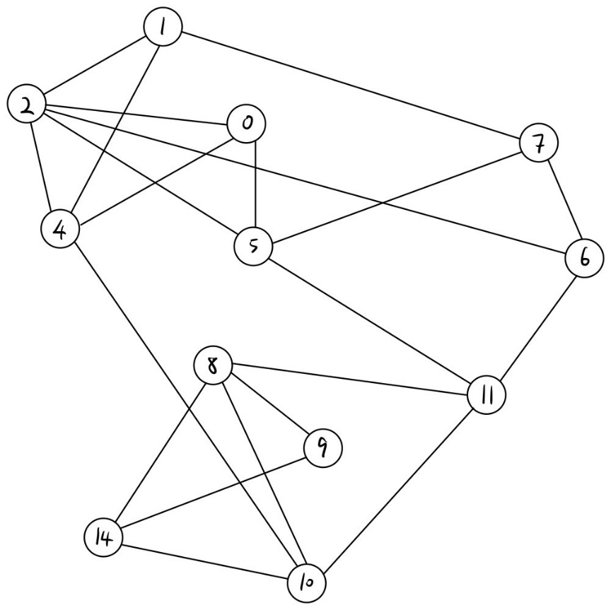
Algorithm
DPNLP :
- find core nodes and diffuse their label
node
0 | 1 | 2 | 4 | 5 | 6 | 7 | 8 | 9 | 10 | 11 | 14
0 | 1 | 2 | 4 | 5 | 6 | 7 | 8 | 9 | 10 | 11 | 14
label
$$degree\left(2\right)≥ {(\frac{33}{21})}^{2}$$
$$degree\left(2\right)≥average_degree(Γ(2))$$
$$\frac{degree\left(2\right)+average_degree(Γ(2))}{2}≥4.714$$
Start to diffuse label to it’s neighbors !
2023/05/17

Slide 25
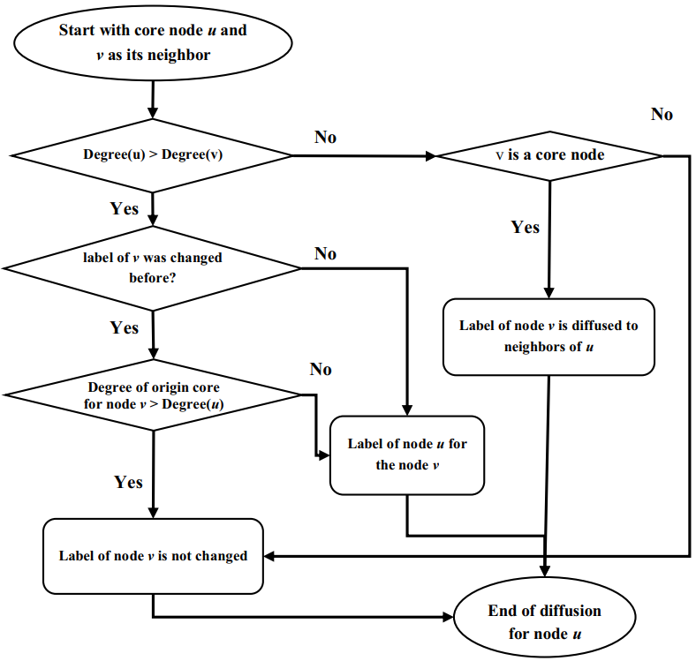
Algorithm
DPNLP :
- find core nodes and diffuse their label
$$u=2 , v=0$$
$$u=2 , v=1$$
Node 0
Node 1
$$deg\left(2\right)=7>deg\left(0\right)=3$$
$$deg\left(2\right)=7>deg\left(1\right)=3$$
$$label\left(0\right)←2$$
$$label\left(1\right)←2$$
2023/05/17

Slide 26
Algorithm
DPNLP :
- find core nodes and diffuse their label
node
0 | 1 | 2 | 4 | 5 | 6 | 7 | 8 | 9 | 10 | 11 | 14
2 | 2 | 2 | 2 | 2 | 2 | 7 | 8 | 9 | 10 | 11 | 14
label
2023/05/17

Slide 27
Algorithm
DPNLP :
- find core nodes and diffuse their label
node
0 | 1 | 2 | 4 | 5 | 6 | 7 | 8 | 9 | 10 | 11 | 14
2 | 2 | 2 | 2 | 2 | 2 | 7 | 8 | 9 | 10 | 11 | 14
label
Find node 8 is core node
$$degree\left(8\right)≥ {(\frac{33}{21})}^{2}$$
$$degree\left(8\right)≥average_degree(Γ(8))$$
$$\frac{degree\left(8\right)+average_degree(Γ(8))}{2}≥4.714$$
Start to diffuse label to it’s neighbors !
2023/04/10
2023/05/17

Slide 28

Algorithm
DPNLP :
- find core nodes and diffuse their label
$$u=8 , v=9$$
$$u=8 , v=10$$
Node 9
Node 10
$$node 10 hasn^{′}t been visit$$
$$so don^{′}t know$$
$$deg\left(8\right)=6>deg\left(9\right)=3$$
$$deg\left(8\right)=6>deg\left(10\right)=7$$
$$label\left(9\right)←8$$
$$label\left(10\right) remain$$
2023/05/17

Slide 29
Algorithm
DPNLP :
- find core nodes and diffuse their label
node
0 | 1 | 2 | 4 | 5 | 6 | 7 | 8 | 9 | 10 | 11 | 14
2 | 2 | 2 | 2 | 2 | 2 | 7 | 8 | 8 | 10 | 11 | 8
label
$$remain$$
2023/04/10
2023/05/17

Slide 30
Algorithm
DPNLP :
- find core nodes and diffuse their label
node
node
0 | 1 | 2 | 4 | 5 | 6 | 7 | 8 | 9 | 10 | 11 | 14
2 | 2 | 2 | 2 | 2 | 2 | 7 | 8 | 8 | 10 | 11 | 8
0 | 1 | 2 | 4 | 5 | 6 | 7 | 8 | 9 | 10 | 11 | 14
2 | 2 | 2 | 10 | 2 | 2 | 7 | 10 | 8 | 10 | 10 | 10
label
label
Find node 10 is core node
$$degree\left(10\right)≥ {(\frac{33}{21})}^{2}$$
$$degree\left(10\right)≥average_degree(Γ(10))$$
$$\frac{degree\left(10\right)+average_degree(Γ(10))}{2}≥4.714$$
Start to diffuse label to it’s neighbors !
2023/04/10
2023/05/17

Slide 31
Algorithm
DPNLP :
- find core nodes and diffuse their label
node
node
0 | 1 | 2 | 4 | 5 | 6 | 7 | 8 | 9 | 10 | 11 | 14
2 | 2 | 2 | 10 | 2 | 2 | 7 | 10 | 8 | 10 | 10 | 10
label
label
Find node 11 is core node
$$degree\left(11\right)≥ {(\frac{33}{21})}^{2}$$
$$degree\left(11\right)≥average_degree(Γ(11))$$
$$\frac{degree\left(11\right)+average_degree(Γ(11))}{2}≥4.714$$
Start to diffuse label to it’s neighbors !
2023/04/10
2023/05/17

Slide 32
Algorithm
DPNLP :
- find core nodes and diffuse their label
$$u=11 , v=5$$
$$u=11 , v=8$$
Node 5
Node 8
$$deg\left(11\right)=6>deg\left(5\right)=4$$
$$node 8 ∈core node$$
$$deg\left(11\right)=6>deg\left(8\right)=6$$
$$label change from 5 to 2$$
$$deg\left(2\right)=7>deg\left(11\right)=6$$
$$label\left(N\left(11\right)\right)←label\left(8\right)=10$$
$$label\left(5\right) remain$$
2023/05/17

Slide 33

Algorithm
DPNLP :
- find core nodes and diffuse their label
node
node
0 | 1 | 2 | 4 | 5 | 6 | 7 | 8 | 9 | 10 | 11 | 14
2 | 2 | 2 | 10 | 10 | 10 | 7 | 10 | 8 | 10 | 10 | 10
0 | 1 | 2 | 4 | 5 | 6 | 7 | 8 | 9 | 10 | 11 | 14
2 | 2 | 2 | 10 | 10 | 10 | 7 | 10 | 8 | 10 | 10 | 10
label
label
$$core node=\{2,8,10,11\}$$
$$the others will asign to peripheral node$$
2023/04/10
2023/05/17

Slide 34
Algorithm
DPNLP :
Initial
Create initial community
Label propagation
Finalizing community
2023/05/17

Slide 35
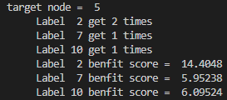
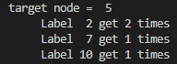
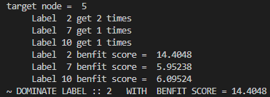
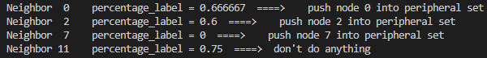
Algorithm
DPNLP :
- starting doing LPA on peripheral nodes
node
0 | 1 | 2 | 4 | 5 | 6 | 7 | 8 | 9 | 10 | 11 | 14
2 | 2 | 2 | 2 | 2 | 10 | 7 | 10 | 8 | 10 | 10 | 10
0 | 1 | 2 | 4 | 5 | 6 | 7 | 8 | 9 | 10 | 11 | 14
2 | 2 | 2 | 2 | 10 | 10 | 7 | 10 | 8 | 10 | 10 | 10
0 | 1 | 2 | 4 | 5 | 6 | 7 | 8 | 9 | 10 | 11 | 14
2 | 2 | 2 | 2 | 2 | 10 | 7 | 10 | 8 | 10 | 10 | 10
label
$$peripheral node=\{0,1,4,5,6,7,9,14\}$$
$$peripheral node=\{0,1,4,6,7,9,14\}$$
$$peripheral node=\{0,1,4,6,7,9,14,2\}$$
$$assume randomly select node 5$$
$$assume randomly select node 5$$
$$label changes , check it^{′}s neighbor$$
$$choose label with largest Benefit score as dominate label$$
2023/04/10
2023/05/17

Slide 36
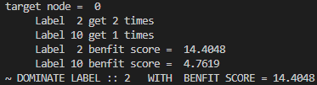
Algorithm
DPNLP :
- starting doing LPA on peripheral nodes
node
0 | 1 | 2 | 4 | 5 | 6 | 7 | 8 | 9 | 10 | 11 | 14
2 | 2 | 2 | 2 | 2 | 10 | 7 | 10 | 8 | 10 | 10 | 10
label
$$peripheral node=\{0,1,4,6,7,9,14,2\}$$
$$peripheral node=\{1,4,6,7,9,14,2\}$$
$$assume randomly select node 0$$
$$assume randomly select node 0$$
$$label doesn^{′}t change$$
2023/04/10
2023/05/17

Slide 37
Algorithm
DPNLP :
Initial
Create initial community
Label propagation
Finalizing community
2023/05/17

Slide 38
Experiment & Simulation
2023/05/17

Slide 39
Experiment & Simulation
Platform :
Thesis platform :
My simulation platform :
CPU | Intel i5
RAM | 12 GB
OS | -
Implement | Python
CPU | Intel i7-12700
RAM | 16 GB
OS | Ubuntu 20.04.5 LTS
Implement | C++
Compiler | gcc 9.4.0
2023/05/17

Slide 40
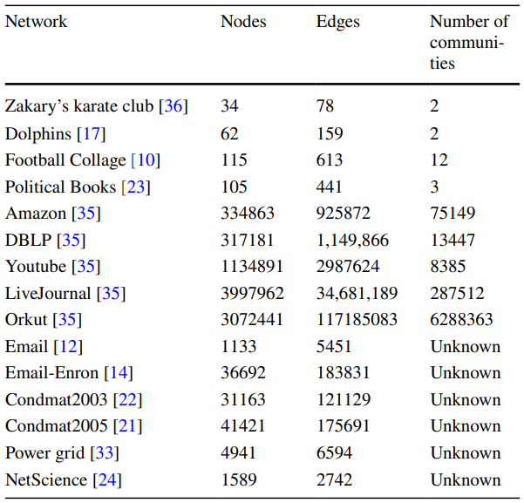
Experiment & Simulation
Dataset :
Real Network
Dataset with ground truth
2023/05/17

Slide 41
Experiment & Simulation
Dataset Source :
-
-
-
-
-
Zachary W. (1977). An information flow model for conflict and fission in small groups. Journal of Anthropological Research, 33, 452-473.
D. Lusseau, K. Schneider, O. J. Boisseau, P. Haase, E. Slooten, and S. M. Dawson, Behavioral Ecology and Sociobiology 54, 396-405 (2003).
M. Girvan and M. E. J. Newman, Proc. Natl. Acad. Sci. USA 99, 7821-7826 (2002).
L. A. Adamic and N. Glance, "The political blogosphere and the 2004 US Election", in Proceedings of the WWW-2005 Workshop on the Weblogging Ecosystem (2005).
SNAP: A General-Purpose Network Analysis and Graph-Mining Library , leskovec2016snap , Marinka Zitnik, Rok Sosi, Sagar Maheshwari, and Jure Leskovec . ACM Transactions on Intelligent Systems and Technology (TIST), 2016 , ACM
2023/05/17

Slide 42
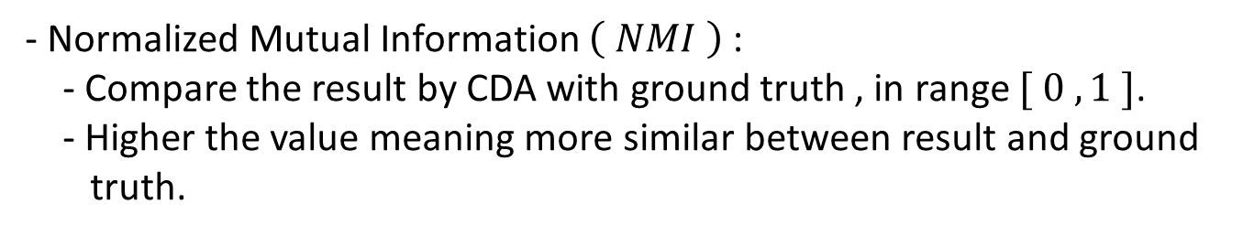
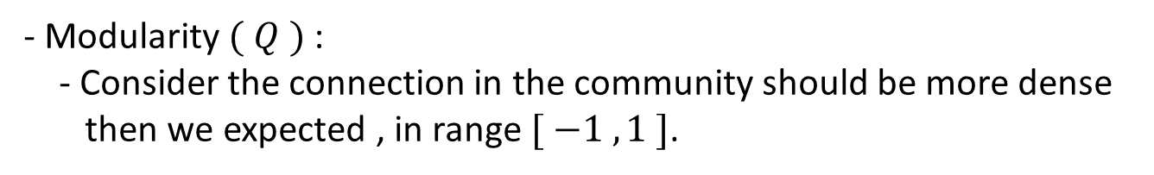
Experiment & Simulation
Measurement :
- Modularity $( Q )$ :
- Consider the connection in the community should be more dense
then we expected , in range $[ −1 , 1 ]$.
- Normalized Mutual Information $\left( NMI \right)$ :
- Compare the result by CDA with ground truth , in range $[ 0 , 1 ]$.
- Higher the value meaning more similar between result and ground
truth.
2023/05/17

Slide 43
Experiment & Simulation
Comparing Algorithms :
- Louvain (2008)
- CNM (2006)
- LPA (2007)
- NIBLPA (2014)
- Infomap (2008)
- G-CN (2019)
- SD-GCN (2020)
- LSMD (2020)
- LCDR (2021)
- PLPAC (2018)
2023/05/17

Slide 44
Experiment & Simulation
Simulation Algorithms :
DPNLP (2022)
Louvain (2008) | Random version 1
 | Random version 2
LPA (2007) | Max iteration = 1000
 | Max iteration = 10000
2023/05/17

Slide 45
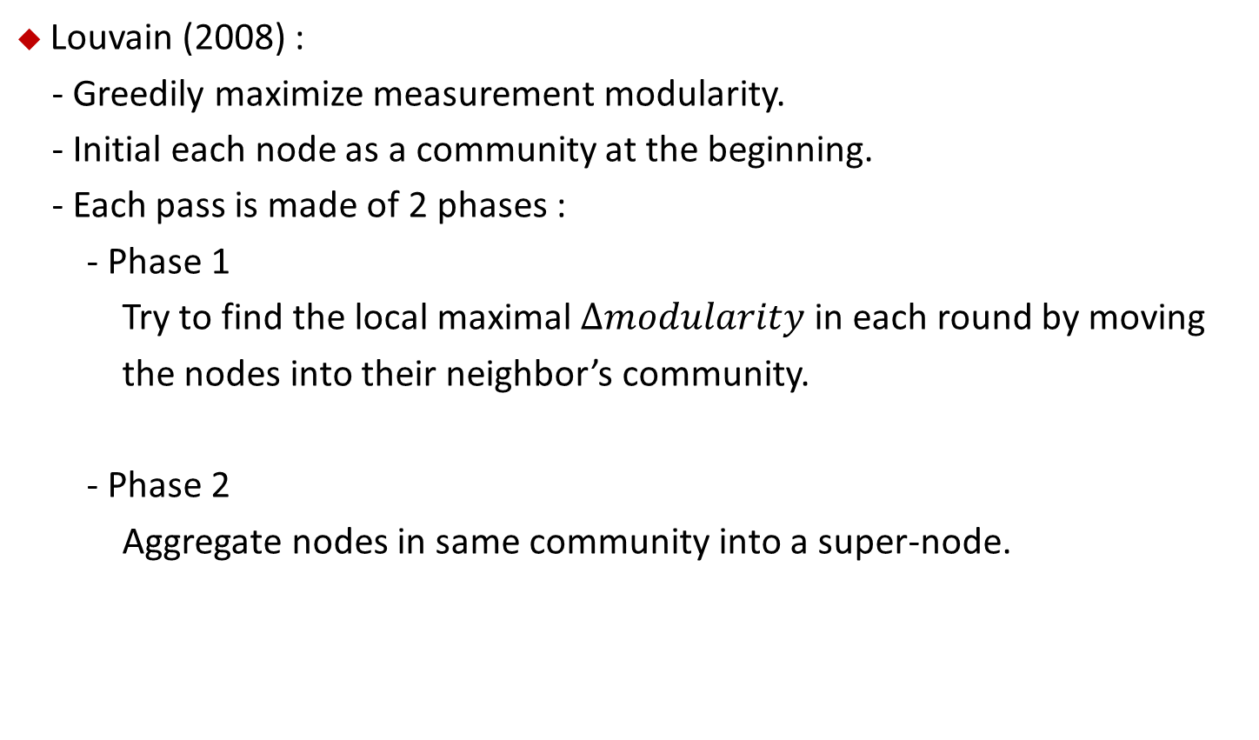
Experiment & Simulation
Louvain (2008) :
- Greedily maximize measurement modularity.
- Initial each node as a community at the beginning.
- Each pass is made of 2 phases :
- Phase 1
Try to find the local maximal $∆modularity$ in each round by moving
the nodes into their neighbor’s community.
- Phase 2
Aggregate nodes in same community into a super-node.
Blondel ,Vincent D , Guillaume ,Jean-Loup . Fast unfolding of communities in large networks 2008 . Journal of Statistical Mechanics : Theory and Experiment P10008.
2023/05/17

Slide 46
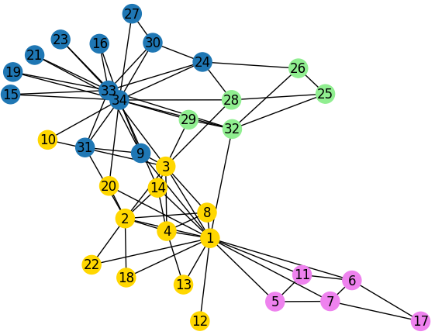
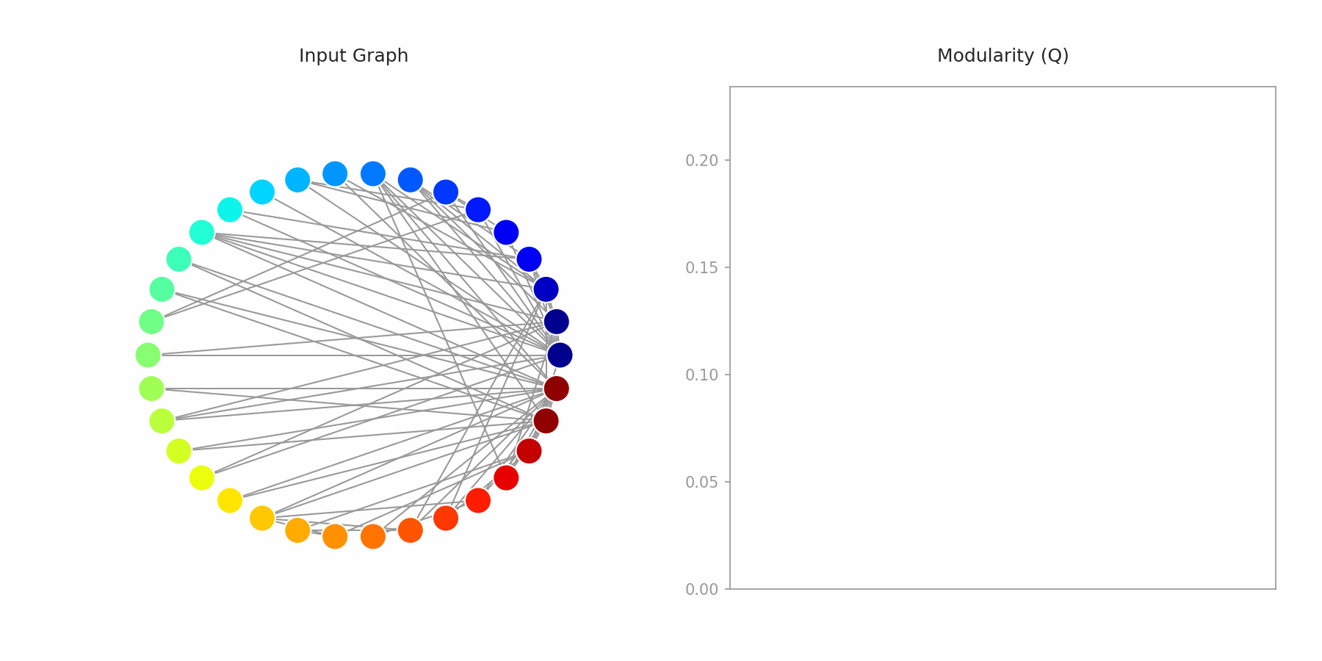
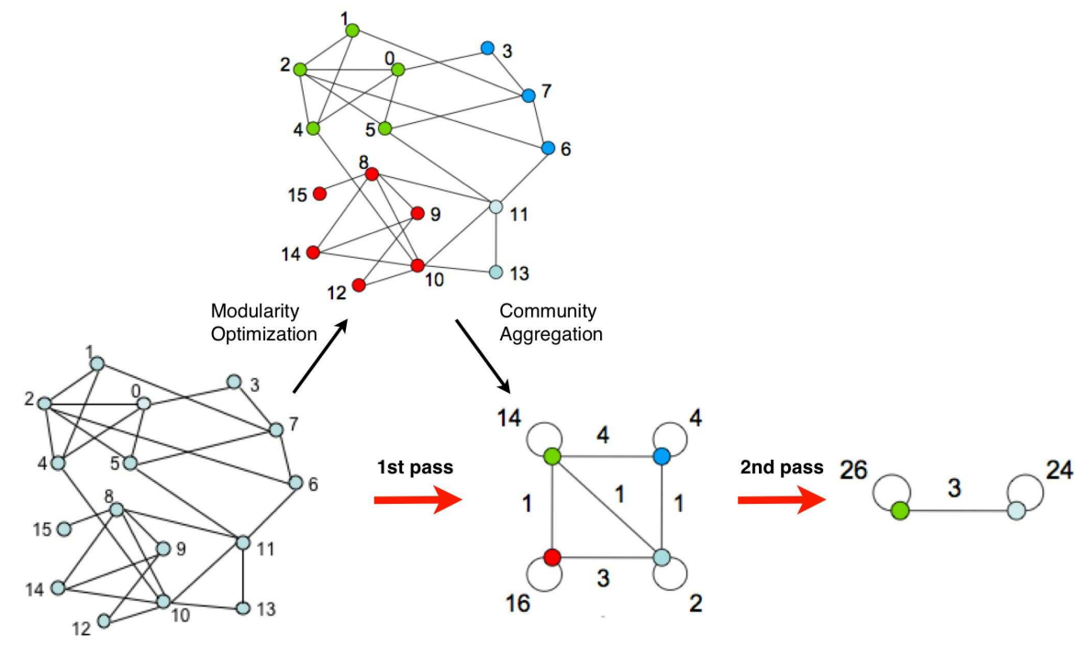
Experiment & Simulation
Louvain (2008) :
- Karate dataset
- Phase 2
- Phase 1
Phase 2
Blondel ,Vincent D , Guillaume ,Jean-Loup . Fast unfolding of communities in large networks 2008 . Journal of Statistical Mechanics : Theory and Experiment P10008.
2023/05/17
Jonatha Shobrook , GITHUB communities .
URL : https://github.com/shobrook/communities/blob/master/img/demo.gif
W. W. Zachary, Aninformation flow model for conflict and fission in small groups, Journal ofAnthropological Research 33, 452-473 (1977).

Slide 47
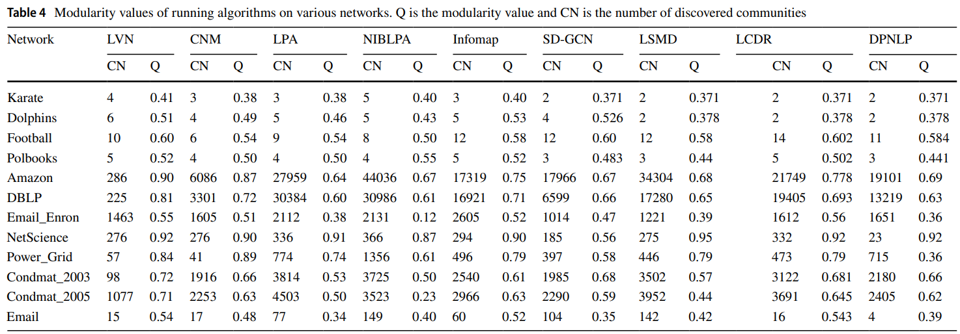
Experiment & Simulation
Modularity ( thesis ) :
2023/05/17
Notes:
CN : 取小數點第一位四捨五入

Slide 48
Experiment & Simulation
Modularity ( My simulation ) :
 | DPNLP |  | Lvn_ran_ver2 |  | LPA (10000) |  | LPA (1000)
 | CN Q |  | CN Q |  | CN Q |  | CN Q
Karate | 2 | 0.3665 | 4 | 0.4111 | 2 | 0.3335 | 2 | 0.3334
Dolphin | 2 | 0.3949 | 5 | 0.5189 | 6 | 0.4228 | 6 | 0.4296
Football | 9 | 0.5892 | 9 | 0.5980 | 11 | 0.5948 | 11 | 0.5929
Polbooks | 3 | 0.4515 | 4 | 0.5164 | 3 | 0.4918 | 3 | 0.489
DBLP | 6766 | 0.3814 | 117 | 0.8092 | 21412 | 0.6762 | 22379 | 0.6882
Amazon | 15306 | 0.7766 | 131 | 0.9175 | 22310 | 0.7859 | 22271 | 0.7864
Youtube | 6335 | 0.2144 | 4109 | 0.7087 | 36673 | 0.5177 | 38351 | 0.6333
Algo
Dataset
2023/05/17
Notes:
CN : 取小數點第一位四捨五入

Slide 49
Experiment & Simulation
Modularity ( My simulation ) :111
 | DPNLP |  | Lvn_ran_ver2 |  | LPA (10000) |  | LPA (1000)
 | CN Q |  | CN Q |  | CN Q |  | CN Q
Karate | 2 | 0.3665 | 4 | 0.4111 | 2 | 0.3335 | 2 | 0.3334
Dolphin | 2 | 0.3949 | 5 | 0.5189 | 6 | 0.4228 | 6 | 0.4296
Football | 9 | 0.5892 | 9 | 0.5980 | 11 | 0.5948 | 11 | 0.5929
Polbooks | 3 | 0.4515 | 4 | 0.5164 | 3 | 0.4918 | 3 | 0.489
DBLP | 7487 | 0.5112 | 116 | 0.8092 | 21642 | 0.679 | 22220 | 0.6864
Amazon | 15198 | 0.7766 | 127 | 0.9173 | 22313 | 0.7862 | 22330 | 0.7859
Youtube | 6177 | 0.2142 | 4145 | 0.7067 | 36716 | 0.5565 | 39026 | 0.616
Algo
Dataset
2023/05/17
Notes:
CN : 取小數點第一位四捨五入

Slide 50
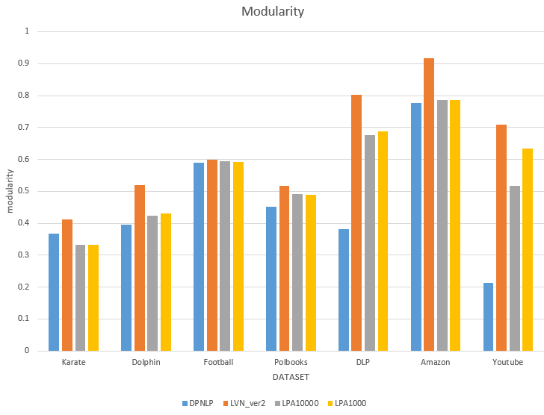
Experiment & Simulation
Modularity ( My simulation ) :
2023/05/17
Notes:
CN : 取小數點第一位四捨五入

Slide 51
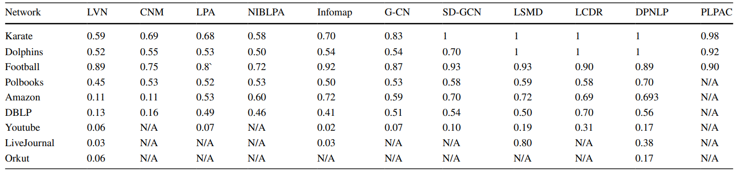
Experiment & Simulation
NMI ( thesis ) :
2023/05/17

Slide 52
Experiment & Simulation
NMI ( My simulation ) :
 | DPNLP | Lvn_ran_ver2 | LPA (10000) | LPA (1000)
Karate | 1 | 0.6374 | 0.6892 | 0.6994
Dolphin | 0.8539 | 0.4353 | 0.4155 | 0.4238
Football | 0.2282 | 0.2145 | 0.2502 | 0.2508
Polbooks | 0.5659 | 0.5404 | 0.5670 | 0.5723
DBLP | 0.323 | 0.3469 | 0.5715 | 0.5829
Amazon | 0.6453 | 0.5084 | 0.6547 | 0.6547
Youtube | 0.0207 | 0.0575 | 0.0456 | 0.0476
Algo
Dataset
2023/05/17

Slide 53
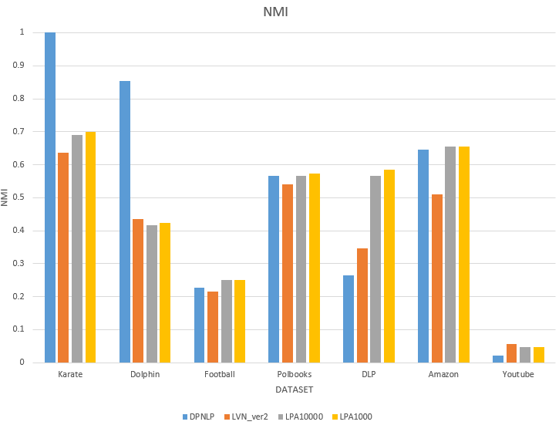
Experiment & Simulation
NMI ( My simulation ) :
2023/05/17

Slide 54
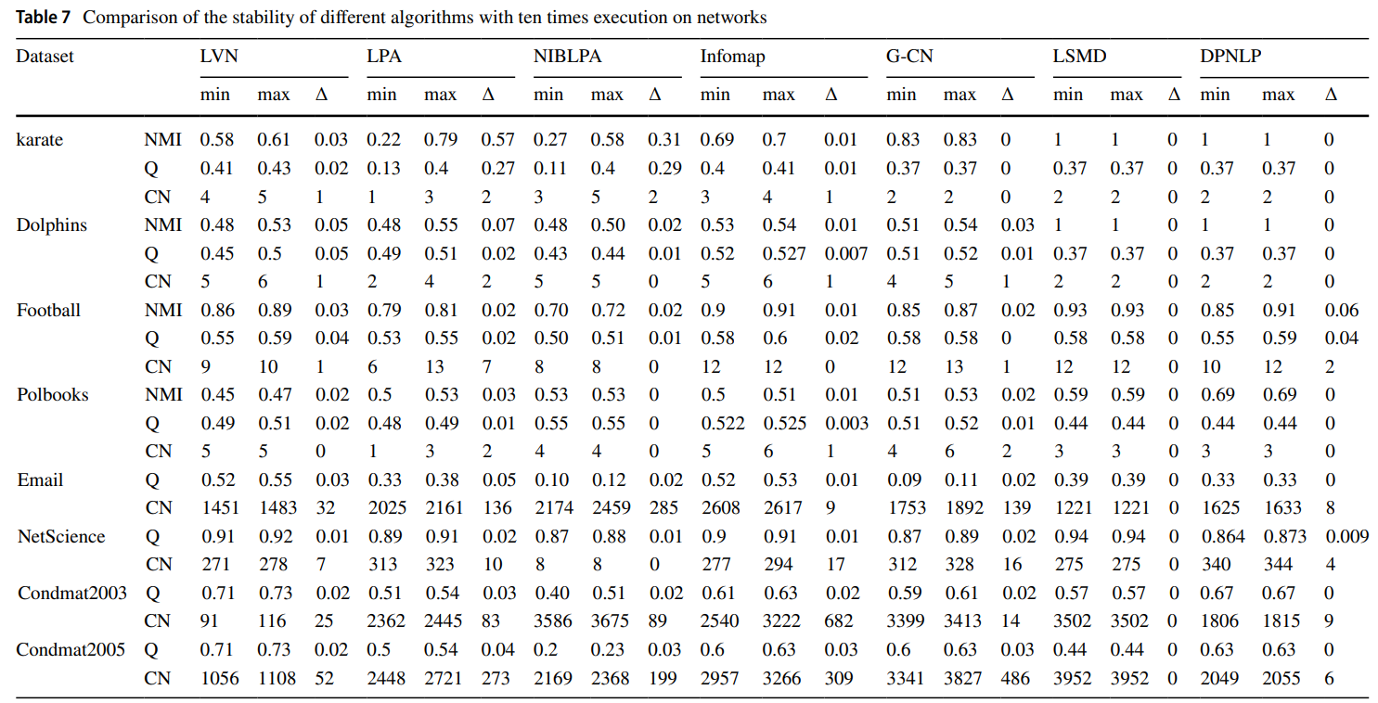
Experiment & Simulation
Results stable ( thesis ) :
2023/05/17

Slide 55

Experiment & Simulation
Results stable ($∆Modularity$) ( My simulation ) :
 | DPNLP | Lvn_ran_ver2 | LPA (10000) | LPA (1000)
Karate | 0 | 0.0464 | 0.402 | 0.4151
Dolphin | 0.0588 | 0.0446 | 0.1647 | 0.0818
Football | 0.0751 | 0.03911 | 0.0499 | 0.0572
Polbooks | 0.0111 | 0.0423 | 0.0546 | 0.055
DBLP | 0.1982 | 0.0022 | 0.0324 | 0.0316
Amazon | 0.003 | 0.0015 | 0.0017 | 0.0041
Youtube | 0.0007 | 0.0255 | 0.2751 | 0.4215
Algo
Dataset
2023/05/17

Slide 56

Experiment & Simulation
Results stable ($∆NMI$) ( My simulation ) :
 | DPNLP | Lvn_ran_ver2 | LPA (10000) | LPA (1000)
Karate | 0 | 0.3029 | 1 | 1
Dolphin | 0.2126 | 0.1366 | 0.324 | 0.1956
Football | 0.135 | 0.0865 | 0.0869 | 0.0849
Polbooks | 0.166 | 0.1288 | 0.1165 | 0.1091
DBLP | 0.0557 | 0.01 | 0.0718 | 0.0632
Amazon | 0.0014 | 0.0084 | 0.0005 | 0.0005
Youtube | 0.0018 | 0.0014 | 0.0098 | 0.013
Algo
Dataset
2023/05/17

Slide 57

Experiment & Simulation
Results stable ($∆CN$) ( My simulation ) :
 | DPNLP | Lvn_ran_ver2 | LPA (10000) | LPA (1000)
Karate | 0 | 1 | 3 | 3
Dolphin | 2 | 2 | 3 | 2
Football | 7 | 3 | 4 | 4
Polbooks | 0 | 2 | 3 | 3
DBLP | 474 | 19 | 3942 | 3273
Amazon | 198 | 18 | 103 | 262
Youtube | 564 | 2030 | 8576 | 11898
Algo
Dataset
2023/05/17

Slide 58
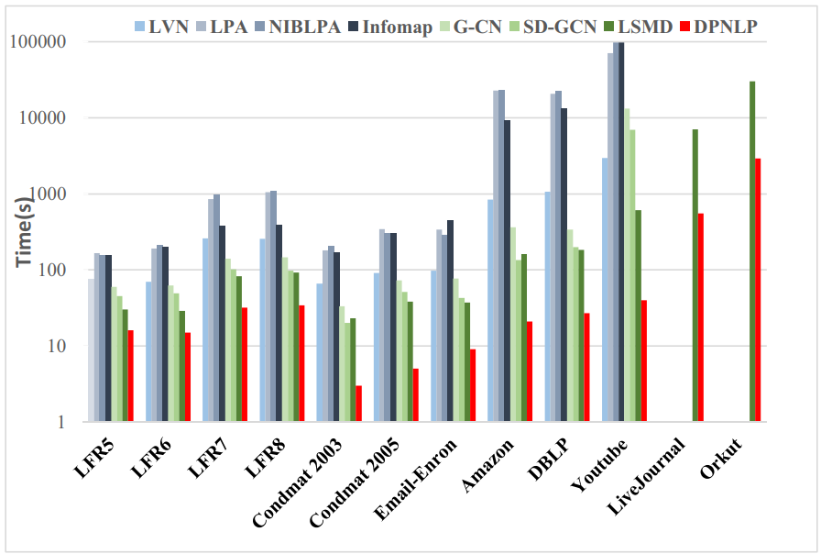
Experiment & Simulation
Execution time ( in second ) ( thesis ) :
2023/05/17

Slide 59
Experiment & Simulation
Execution time ( in second ) ( My simulation ) :
 | DPNLP | Lvn_ran_ver2 | Lvn_ran_ver1 | LPA (10000) | LPA (1000)
Karate | 0.000704 | 0.001684 | 0.001855 | 0.001026 | 0.0010
Dolphin | 0.001749 | 0.002364 | 0.002806 | 0.002684 | 0.002935
Football | 0.007118 | 0.002925 | 0.003756 | 0.002515 | 0.002439
Polbooks | 0.002292 | 0.003143 | 0.003236 | 0.002669 | 0.002703
DBLP | 855.272 | 8.22 | 238.119 | 2157.135 | 227.054
Amazon | 1638.317 | 6.371 | 244.387 | 2029.773 | 203.662
Youtube | 2678.235 | 38.522 | 2257.96 | 6897.55 | 714.241
LiveJournal |  | 332.587 | 5899.219 | - | 8601.846
Algo
Dataset
2023/05/17

Slide 60
Experiment & Simulation
Execution time ( in second ) ( My simulation ) :
 | DPNLP | Lvn_ran_ver2 | Lvn_ran_ver1 | LPA (10000) | LPA (1000)
Karate | 0.000704 | 0.001684 | 0.001855 | 0.001026 | 0.0010
Dolphin | 0.001749 | 0.002364 | 0.002806 | 0.002684 | 0.002935
Football | 0.007118 | 0.002925 | 0.003756 | 0.002515 | 0.002439
Polbooks | 0.002292 | 0.003143 | 0.003236 | 0.002669 | 0.002703
DBLP | 261.3211 | 8.0564 | 554.4795 | 2167.053 | 225.7736
Amazon | 184.3456 | 6.3486 | 708.148 | 2030.938 | 203.8571
Youtube | 159.7537 | 36.852 | 2257.96 | 6933.823 | 719.041
LiveJournal | 33929.436 | 316.8617 |  |  | 4378.32
Algo
Dataset
2023/05/17

Slide 61
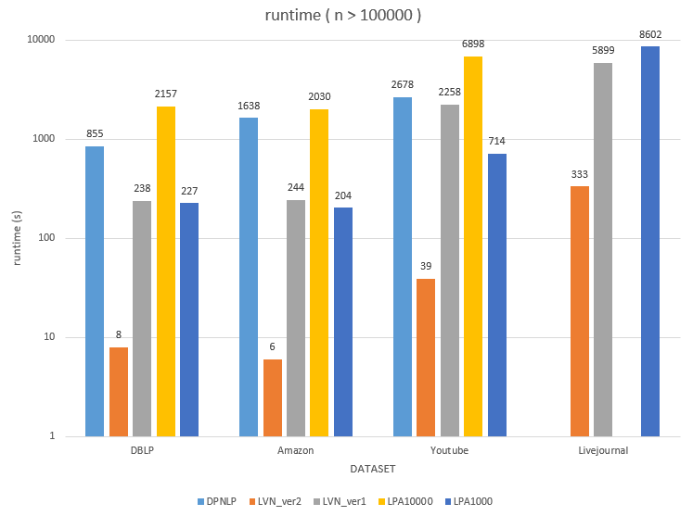
Experiment & Simulation
Execution time ( in second ) ( My simulation ) :
2023/05/17

Slide 62
Conclusion
2023/05/17

Slide 63
Conclusion
Pros of this paper :
- Results are as same as possible in small dataset, in large dataset cause
my number of simulation wasn’t big enough to figure out.
- Deal with the monster communities in LPA.
- The idea of updating peripheral node decrease the number of node
doing label updating.
- Ignore nodes with degree 1 and 2 could decrease the execution time.
2023/05/17

Slide 64
Thanks for your listening
2023/05/17

